Slide 1
Food Sale Prediction
Thuy An Rue Art
07.18.2021

Slide 2
Outline
Goal: to predict total sale of food in outlet based on given information in data set.
Process:
Study given data set
Clean the data set
Heat map to find correlation from the data
Select optimum model to predict the sale

Slide 3
1. Study given data set
The data set has total 11 columns and 8523 rows
There are two columns that won’t have much contribution to the prediction:
Item_Identifier
Outlet_Identifier

Slide 4
2. Clean the data set
There are missing data in the data set.
The rows containing missing data was dropped/ eliminated from the whole data set.

Slide 5
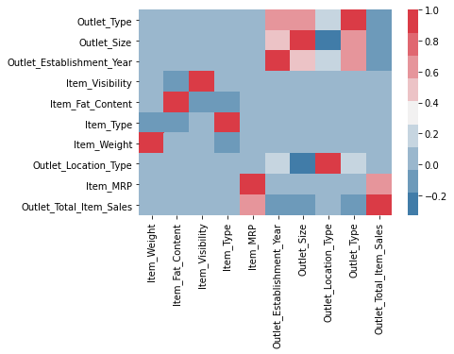
3. Heat map to find correlation from the data
Item market price seemed to be the most importance features contributing to the sale of each item.

Slide 6
4. Select optimum model to predict the sale.
KNN- regression
Random Forest (with and without train test slipt)
Bagged Tree (with and without train test slipt)

Slide 7
4. Select optimum model to predict the sale.
Among all the considered models, Random Forest model without using train test slipt seemed to be the most effective way to predict the sale.
Random Forest had score of 0.92.
KNN had score of 0.57 and Bagged Tree had score of 0.89.

Slide 8
4. Select optimum model to predict the sale.
There is unnecessary to use train test slipt because the data set is not large enough.
X_train (3487, 9) vs X_test (1163, 9)

